Slide 1
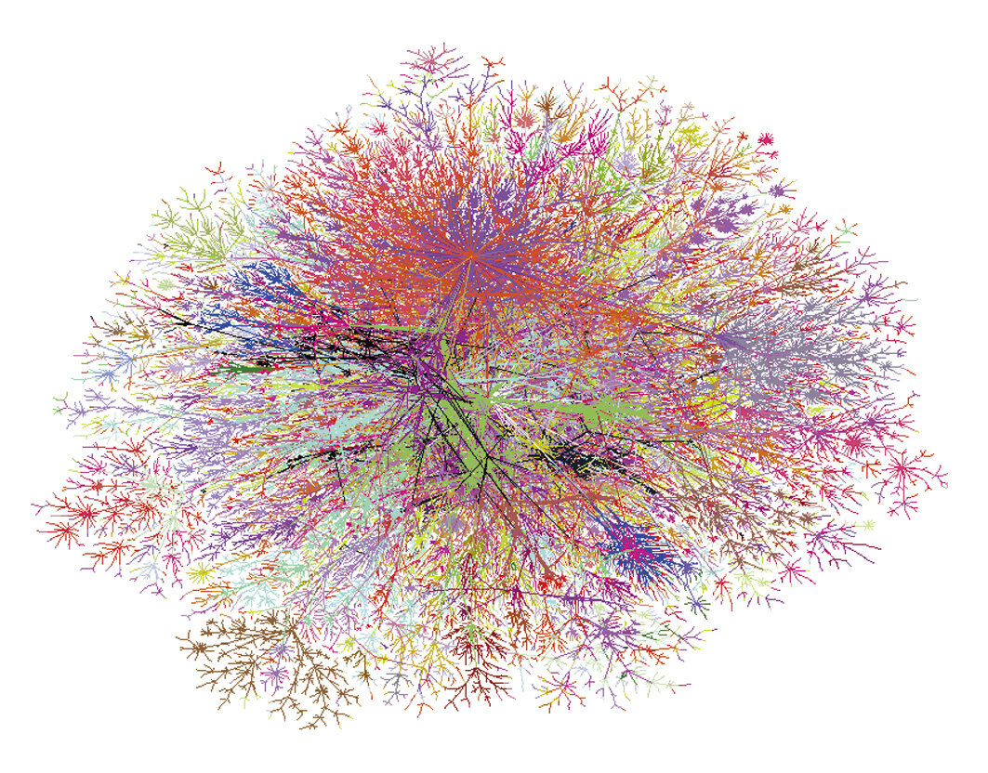
NETWORK DESTROY-REPAIR
October 5, 2022
Vikas Kashyap, Tony Huang (Group 8)

Slide 2
Leading Questions to the Project
Overview
We are motivated by a desire to understand the robustness of networks in the real world
1
WHAT IS THE MOTIVATION OF THE STUDY?
Network robustness is fundamental feature of real-world networks, a lack of which leads to critical system failures. The objective is to evaluate and understand the network robustness under different circumstances.
2
WHAT IS THE OBJECTIVE AND TASKS?
The main tasks consist of evaluating the fundamental attributes of the network, designing attack and defense mechanisms, and monitoring how each type of network behaves under the attack and defense scheme.

Slide 3
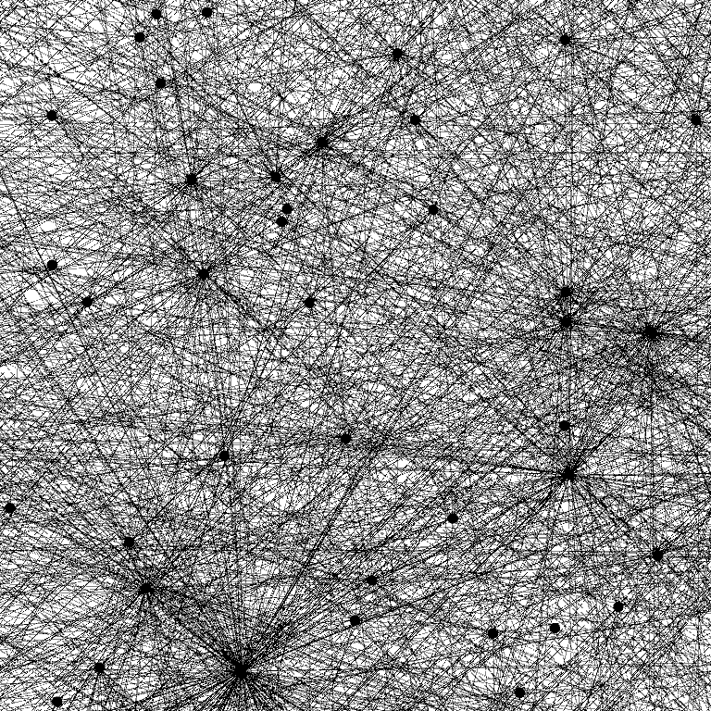
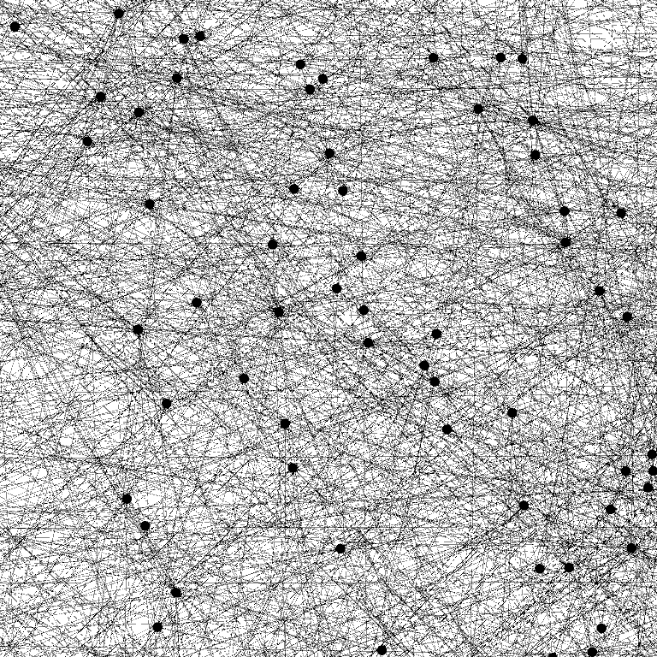
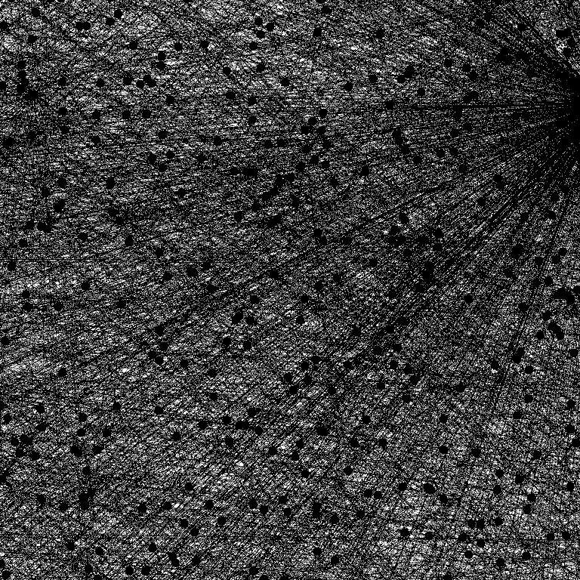
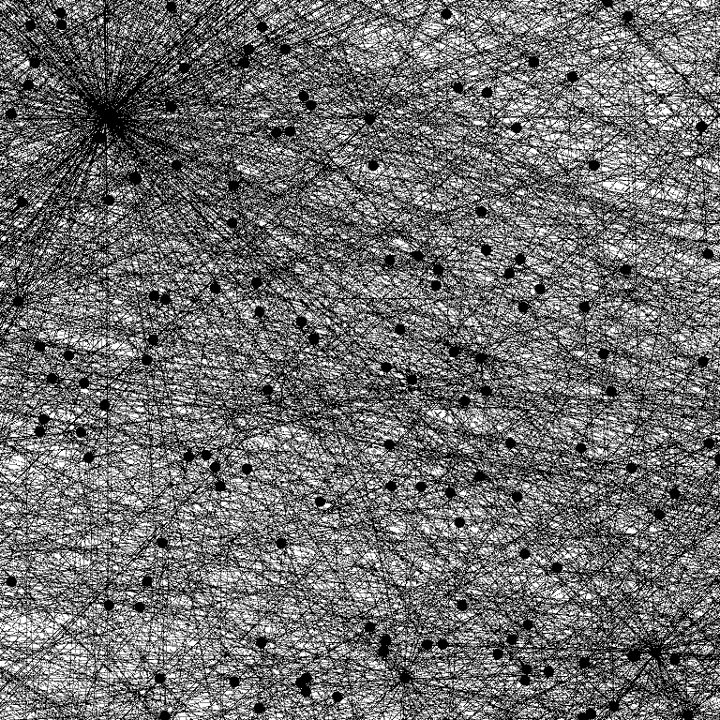
Target Networks of the Project
APPROACH
We have selected four types of networks scenario for further investigation
1
2
3
4
SOCIAL NETWORK
P2P NETWORK
AUTONOMOUS SYSTEM
EMAIL NETWORK
Bad actors may be incentivized to disguise themselves and connect with people on Facebook/Twitter.
Malware can be transmitted when ill-intentioned nodes are connected in the network.
Internet communication protocols must be maintained to prevent spreading of misinformation
Spams can be an annoying part of life, if malicious links are not removed from the network

Slide 4
Main Steps and Assumptions of the Project
APPROACH
The project is primarily pursued through three main steps
1. UNDERSTAND BASIC PROPERTIES OF THE NETWORK
In the first step, we will comprehensively dissect the network, using the various concepts that are covered in lecture (e.g., number of nodes/edges, clustering coefficient, diameter, etc.)
2. DESIGN ATTACK AND REPAIR MECHANISMS
In the second step, we will design a set of algorithms that removes and repairs the links in the networks, and we will iterate our algorithms starting with a random removal and repair mechanism.
3. FORMULATE HYPOTHESIS ON NETWORK ROBUSTNESS
Finally, we want to explore the consequences of our result and consolidate our results to demonstrate the robustness of each network and propose reasons to explain why certain networks are more robust than others.
MAIN ASSUMPTIONS
We are assuming that the networks selected are sufficiently representative of their real-world counterparts
We are assuming the attacker has sufficient access to and knowledge about the graphs and their structural information

Slide 5
Basic Findings and Anticipated Challenges
PRELIMINARY RESULTs
We investigated the basic properties of the networks and proposed three potential problems
Social
Network
P2P
Network
Autonomous
System
Email
Network
POTENTIAL CHALLENGES
Directed or undirected? | Directed | Directed | Undirected | Undirected
# of nodes | 81,306 | 62,586 | 10,900 | 36,692
# of edges | 1,768,149 | 147,892 | 31,180 | 183,831
Average degree | 43 | 4.73 | 5.72 | 10.02
Diameter | 7 | 11 | 9 | 11
Average clustering coefficient | 0.40 | 0.0027 | 0.501 | 0.716
Global clustering coefficient | 0.11 | 0.0039 | 0.0386 | 0.0213
i.
Long experimental run-time: due to the large number of network nodes and edges, each game experiment could take an extended period of time
ii.
Finding a smart attack/defense system: we want to design intelligent mechanisms that is based on heuristic and not random selection of links
iii.
Finding appropriate robustness measurement metrics: we want to standardize a way to measure robustness across different networks for comparison

Slide 6
Roadmap of the Project
TIMELINE AND DIVISION OF LABOR
We will divide and conquer equally the design and implement of the attack and defense algorithms for our next milestone
SEPTEMBER
OCTOBER
NOVEMBER
Project Milestone 1
Project Preparation
Brainstorm idea and select project topics
Literature review and data sourcing
✓
✓
Design and Implementation
Design and implement network attack algorithm (Tony)
Design and implement network defense algorithm (Vikas)
Assessment and Result Consolidation
Gather key findings from experiments
Summarize experimental approaches and findings

Slide 7
Summary and Next Steps
Conclusions
We will further investigate network robustness by designing and implementing attack and defense algorithms
MOTIVATION
APPROACH
NEXT-STEP
Robustness is fundamental feature of real-world networks, and the project seeks to evaluate network robustness under different situations
Four networks are selected for further investigation, including social, p2p, email networks and autonomous system
Group members will design and implement attack and defense algorithm on the networks

Slide 8
References
APPENDIX
1. Data source: Stanford SNAP
https://snap.stanford.edu/data/#citnets
2. Network robustness
https://barabasi.com/f/619.pdf
3. Adversarial Attack and Defense on Graph Data: A Survey
https://arxiv.org/pdf/1806.02371.pdf
4. Adversarial Attack on Graph Structured Data
https://arxiv.org/pdf/1806.02371.pdf

